Slide 1
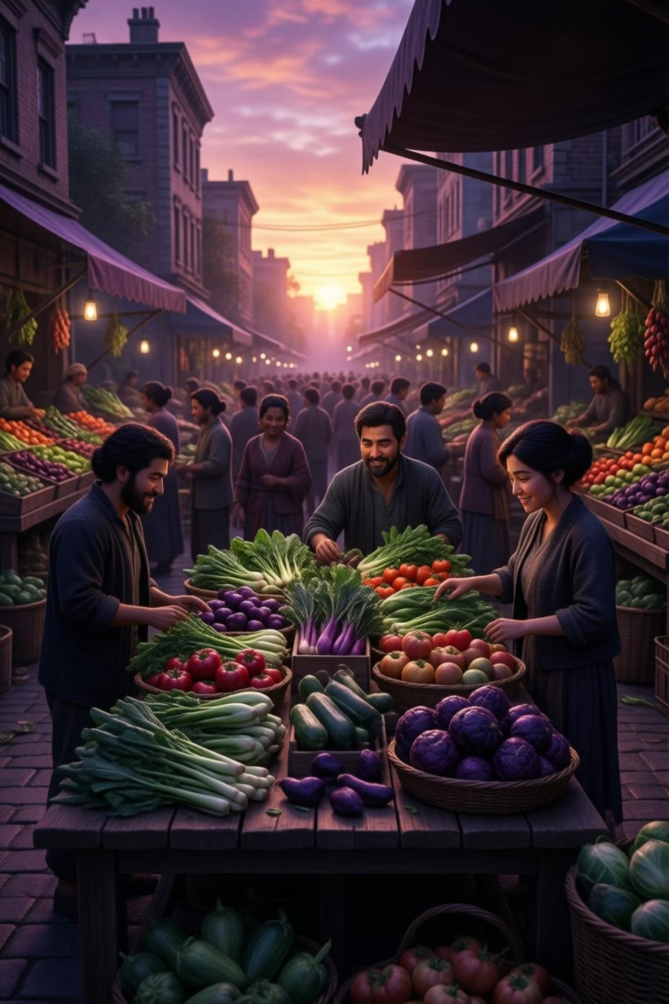

Farm to Table Direct
Connecting farmers and consumers through a transparent digital marketplace that eliminates middlemen and builds healthier communities.

Slide 2
THE CHALLENGE
The Problem with Middlemen
Unfair Farmer Pricing
Inflated Consumer Costs
Lost Market Access
Third-party mediators control pricing, significantly reducing farmers' profits and limiting their economic growth potential.
Intermediaries artificially increase food prices, making organic produce unaffordable for health-conscious families.
Farmers lack direct communication channels with buyers, creating dependency on exploitative middleman systems.

Slide 3

Our Vision for Change
Mission Statement
We're building a dedicated web-based platform that completely eliminates intermediaries, creating direct trade relationships between farmers and consumers.
This transparent digital marketplace ensures fair pricing, promotes organic agriculture, and delivers fresh, healthy food to every table.

Slide 4

Platform Benefits
01
02
Direct Market Access
Transparent Pricing
Farmers list products, set their own prices, and communicate directly with buyers through an intuitive digital interface.
No hidden fees or markup from middlemen—consumers see exactly where their money goes and farmers receive fair compensation.
03
04
Fresh Organic Products
Healthier Communities
Consumers access vegetables, rice, wheat, and other chemical-free agricultural produce at affordable prices.
Promoting nutritious, organic food choices that support daily health and wellness for families nationwide.

Slide 5
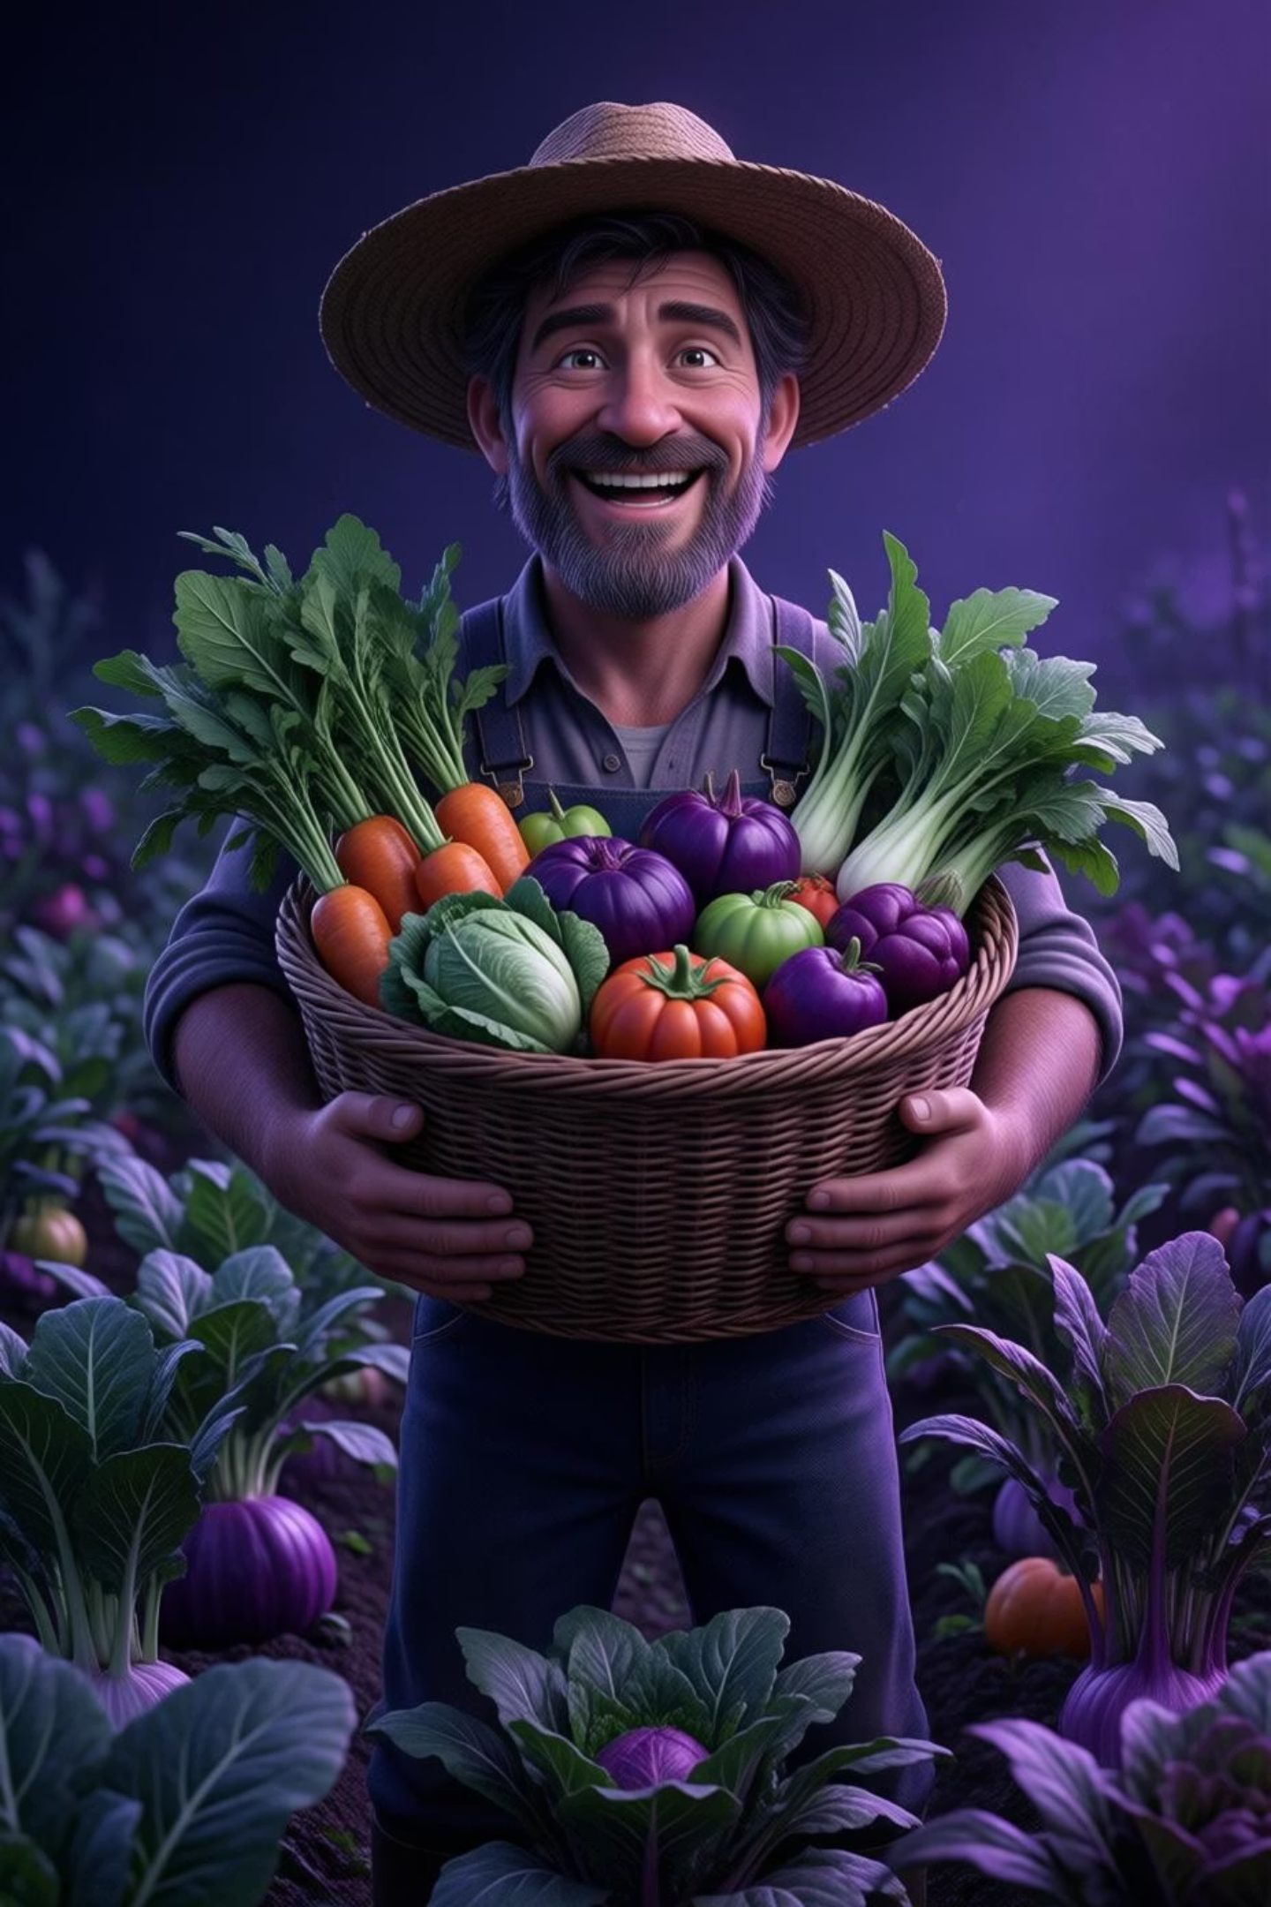

FOR FARMERS
Empowering Agricultural Producers
Economic Benefits
Market Opportunities
Set your own competitive prices without middleman interference
Gain digital presence and reach broader customer base
Receive fair compensation that reflects true product value
Build direct relationships with loyal consumers
Increase income and financial stability for farming families
Showcase organic and sustainable farming practices
Reduce dependency on exploitative third-party systems
Access real-time market demand information

Slide 6

FOR CONSUMERS
Access to Fresh, Affordable Organic Food
Chemical-Free Produce
Affordable Pricing
Know Your Source
Purchase vegetables, grains, and agricultural products grown without harmful pesticides or chemicals.
Enjoy lower costs by eliminating middleman markups while supporting local farmers directly.
Learn about your food's origin, farming practices, and the people who grow what you eat.

Slide 7





How the Platform Works
Farmer Registration
Farmers create profiles showcasing their farms, certifications, and available organic products with photos and descriptions.
Product Listings
Upload inventory including vegetables, rice, wheat, and seasonal produce with pricing, quantities, and delivery options.
Consumer Discovery
Buyers browse offerings, filter by location and product type, and read detailed information about farming practices.
Direct Communication
Built-in messaging enables buyers and sellers to discuss orders, negotiate bulk pricing, and arrange delivery details.
Secure Transactions
Complete purchases through integrated payment systems with transparent pricing—no hidden fees or commissions.

Slide 8

Impact on Food Security & Rural Economy
Sustainable Agriculture
Economic Stability
Food Security
Direct supply chains ensure consistent access to nutritious food while reducing waste and improving distribution efficiency.
Encouraging organic farming practices reduces environmental impact and promotes long-term soil health and biodiversity.
Farmers earn reliable income, strengthening rural economies and reducing urban migration from agricultural communities.

Slide 9
Key Platform Features
1
2
User-Friendly Interface
Real-Time Inventory
Intuitive design accessible on any device, ensuring both tech-savvy and traditional farmers can participate easily.
Automated stock management helps farmers update availability instantly and prevents order fulfillment issues.
3
4
Rating & Reviews
Educational Resources
Build trust through transparent feedback systems where consumers rate product quality and farmer reliability.
Information hub teaching consumers about organic benefits, nutritional value, and supporting sustainable agriculture.
5
6
Delivery Coordination
Analytics Dashboard
Flexible fulfillment options including pickup locations, scheduled deliveries, and community distribution points.
Farmers track sales trends, popular products, and customer preferences to optimize their agricultural planning.

Slide 10



Building a Healthier Future Together
Trust & Transparency
Healthier Society
Economic Empowerment
Fostering genuine relationships between food producers and consumers through open communication.
Promoting nutritious, chemical-free food choices that improve public health and wellness.
Creating fair market opportunities that strengthen farming communities and rural economies.
Join us in revolutionizing the agricultural marketplace. Together, we're eliminating barriers, empowering farmers, and bringing fresh organic food directly to your table—creating lasting social and economic benefits for generations to come.

